Slide 1
Not all of a large system will be well designed.

Slide 2
Strategic Design
Making Models Work in Large Projects
BHAVANA
DAY 46
06/06/2024

Slide 3
Not all of a large system will be well designed.

Slide 4
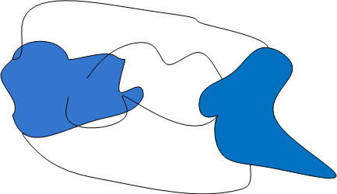
Ground Up Rebuild

Slide 5
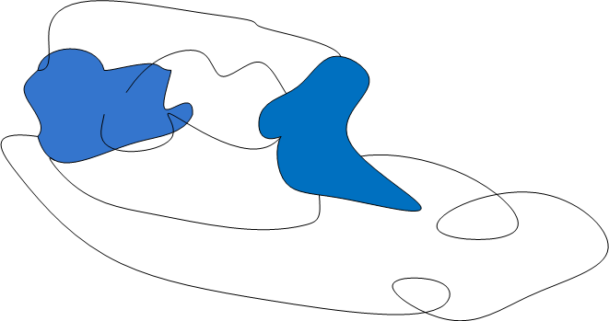
Ground Up Rebuild

Slide 6
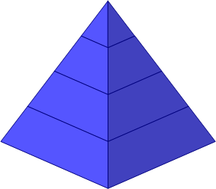
Ground Up Rebuild

Slide 7
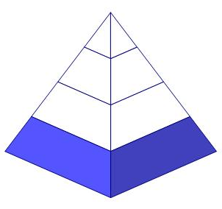
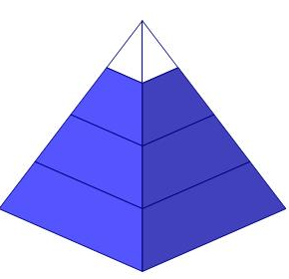
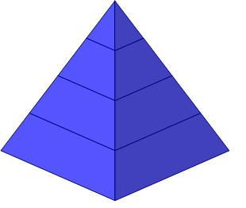
Ground Up Rebuild
Legacy Replaced
Year 1
Exciting New Features
Year 2
Year 3

Slide 8
Let’s Refactor

Slide 9
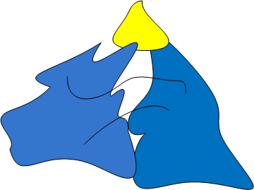
Let’s Refactor

Slide 10
Define Domain
domain A sphere of knowledge, influence, or activity.

Slide 11
Define Domain
domain A sphere of knowledge, influence, or activity.
The subject area to which the user applies a program is the domain of the software.

Slide 12
Why bother with models?

Slide 13
Critical Complexity Is
The critical complexity of most software projects is in understanding the domain itself.

Slide 14
What is a model?

Slide 16
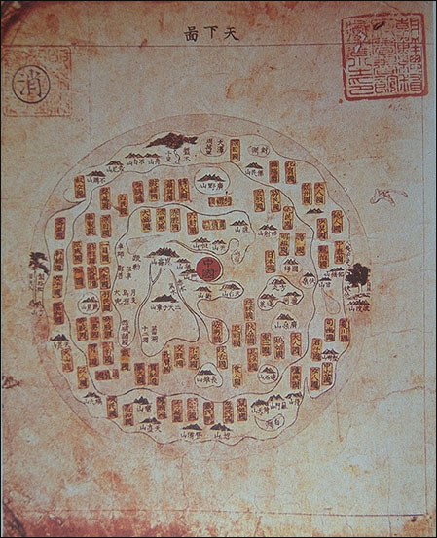
Chinese Map

Slide 17
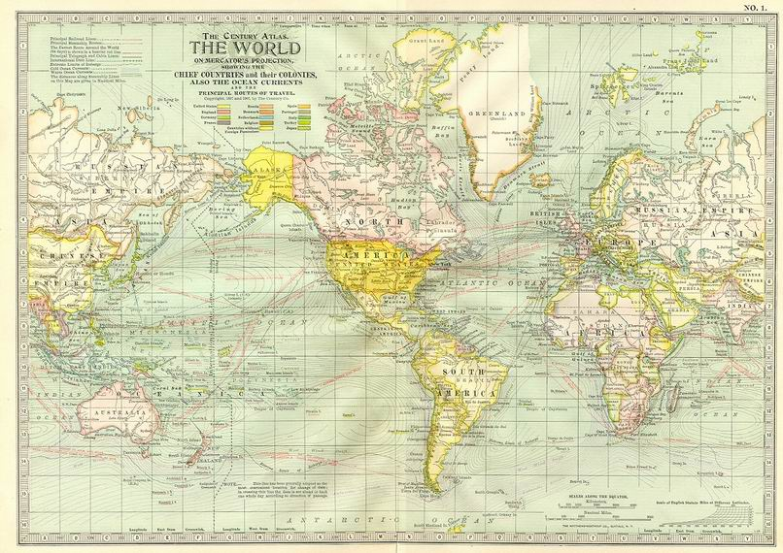
Mercator Map

Slide 18
Define Model
model A system of abstractions that describes selected aspects of a domain and can be used to solve problems related to that domain.

Slide 19
Define Model
model A system of abstractions that describes selected aspects of a domain and can be used to solve problems related to that domain.

Slide 20
Define Model
model A system of abstractions that describes selected aspects of a domain and can be used to solve problems related to that domain.

Slide 21
A Model Serves a Particular Use.

Slide 22
A Model Serves a Particular Use.
Not “as realistic as possible”

Slide 23
A Model Serves a Particular Use.
Not “as realistic as possible”
Useful relative to specific set of domain scenarios

Slide 24
Define Ubiquitous Language
ubiquitous language A language structured around the domain model and used by all team members to connect all the activities of the team with the software.

Slide 25
Define Context
context The setting in which a word or statement appears that determines its meaning.

Slide 26
There are always multiple models.

Slide 27
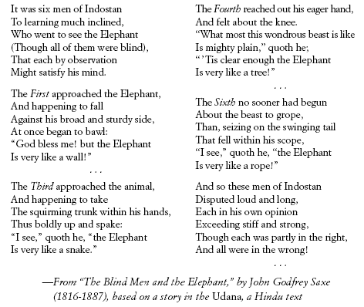

Slide 28
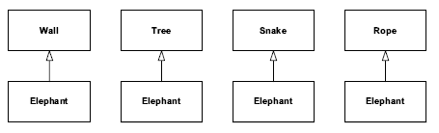

Slide 29
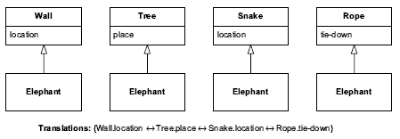

Slide 30
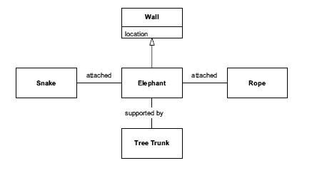

Slide 31
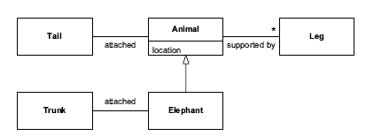

Slide 32

Rowing 8

Slide 33
“Context Map”

Slide 35
cooperative
upstream/downstream

Slide 36


Slide 37
uncooperative
upstream/
downstream

Slide 38


Slide 39
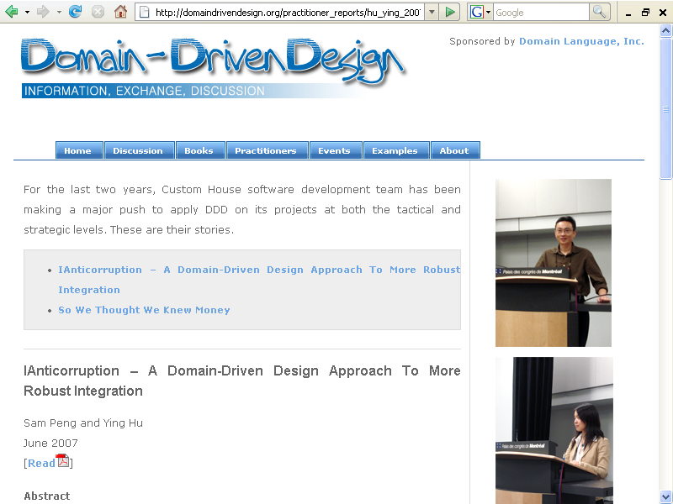


Slide 40
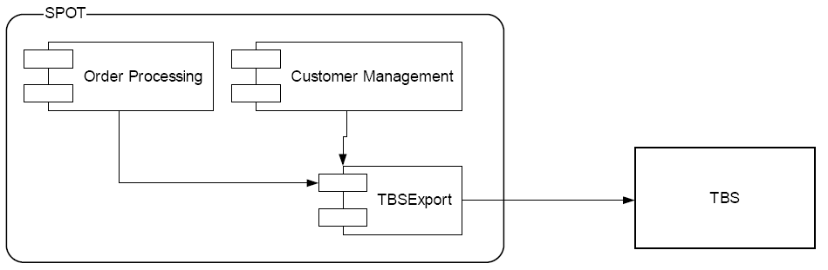
Custom House Currency Exchange System early 2006

Slide 41
Custom House Context Map

Slide 42
Custom House Context Map

Slide 43
Custom House Context Map

Slide 44
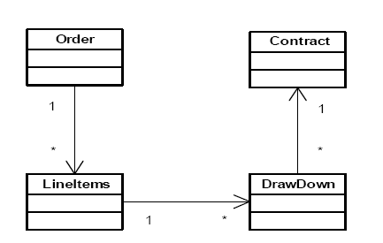
Custom House “SPOT” Model of Currency Exchange Deal

Slide 45
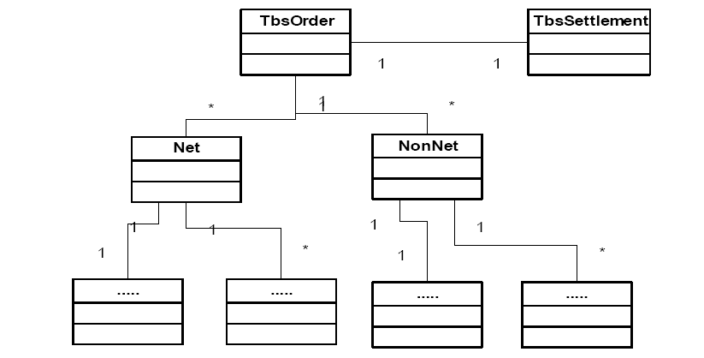
Object Interpretation of Implicit “TBS” Model

Slide 46
Explicit Translation

Slide 47
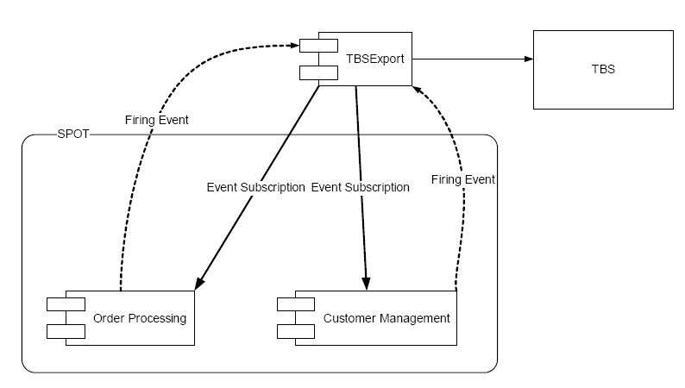
Custom House Currency Exchange System late 2006

Slide 48
Map What Is

Slide 49
Push Translation to the Borders

Slide 50
Single, Unified Model within Any One Context

Slide 51
Single, Unified Model within Any One Context
(Where careful design is going on.)

Slide 52
Single, Unified Model within Any One Context
No duplication...

Slide 53
Single, Unified Model within Any One Context
No duplication...within a context!
Duplication between...

Slide 54
Single, Unified Model within Any One Context
No duplication...within a context!
Duplication between...AOK!

Slide 55
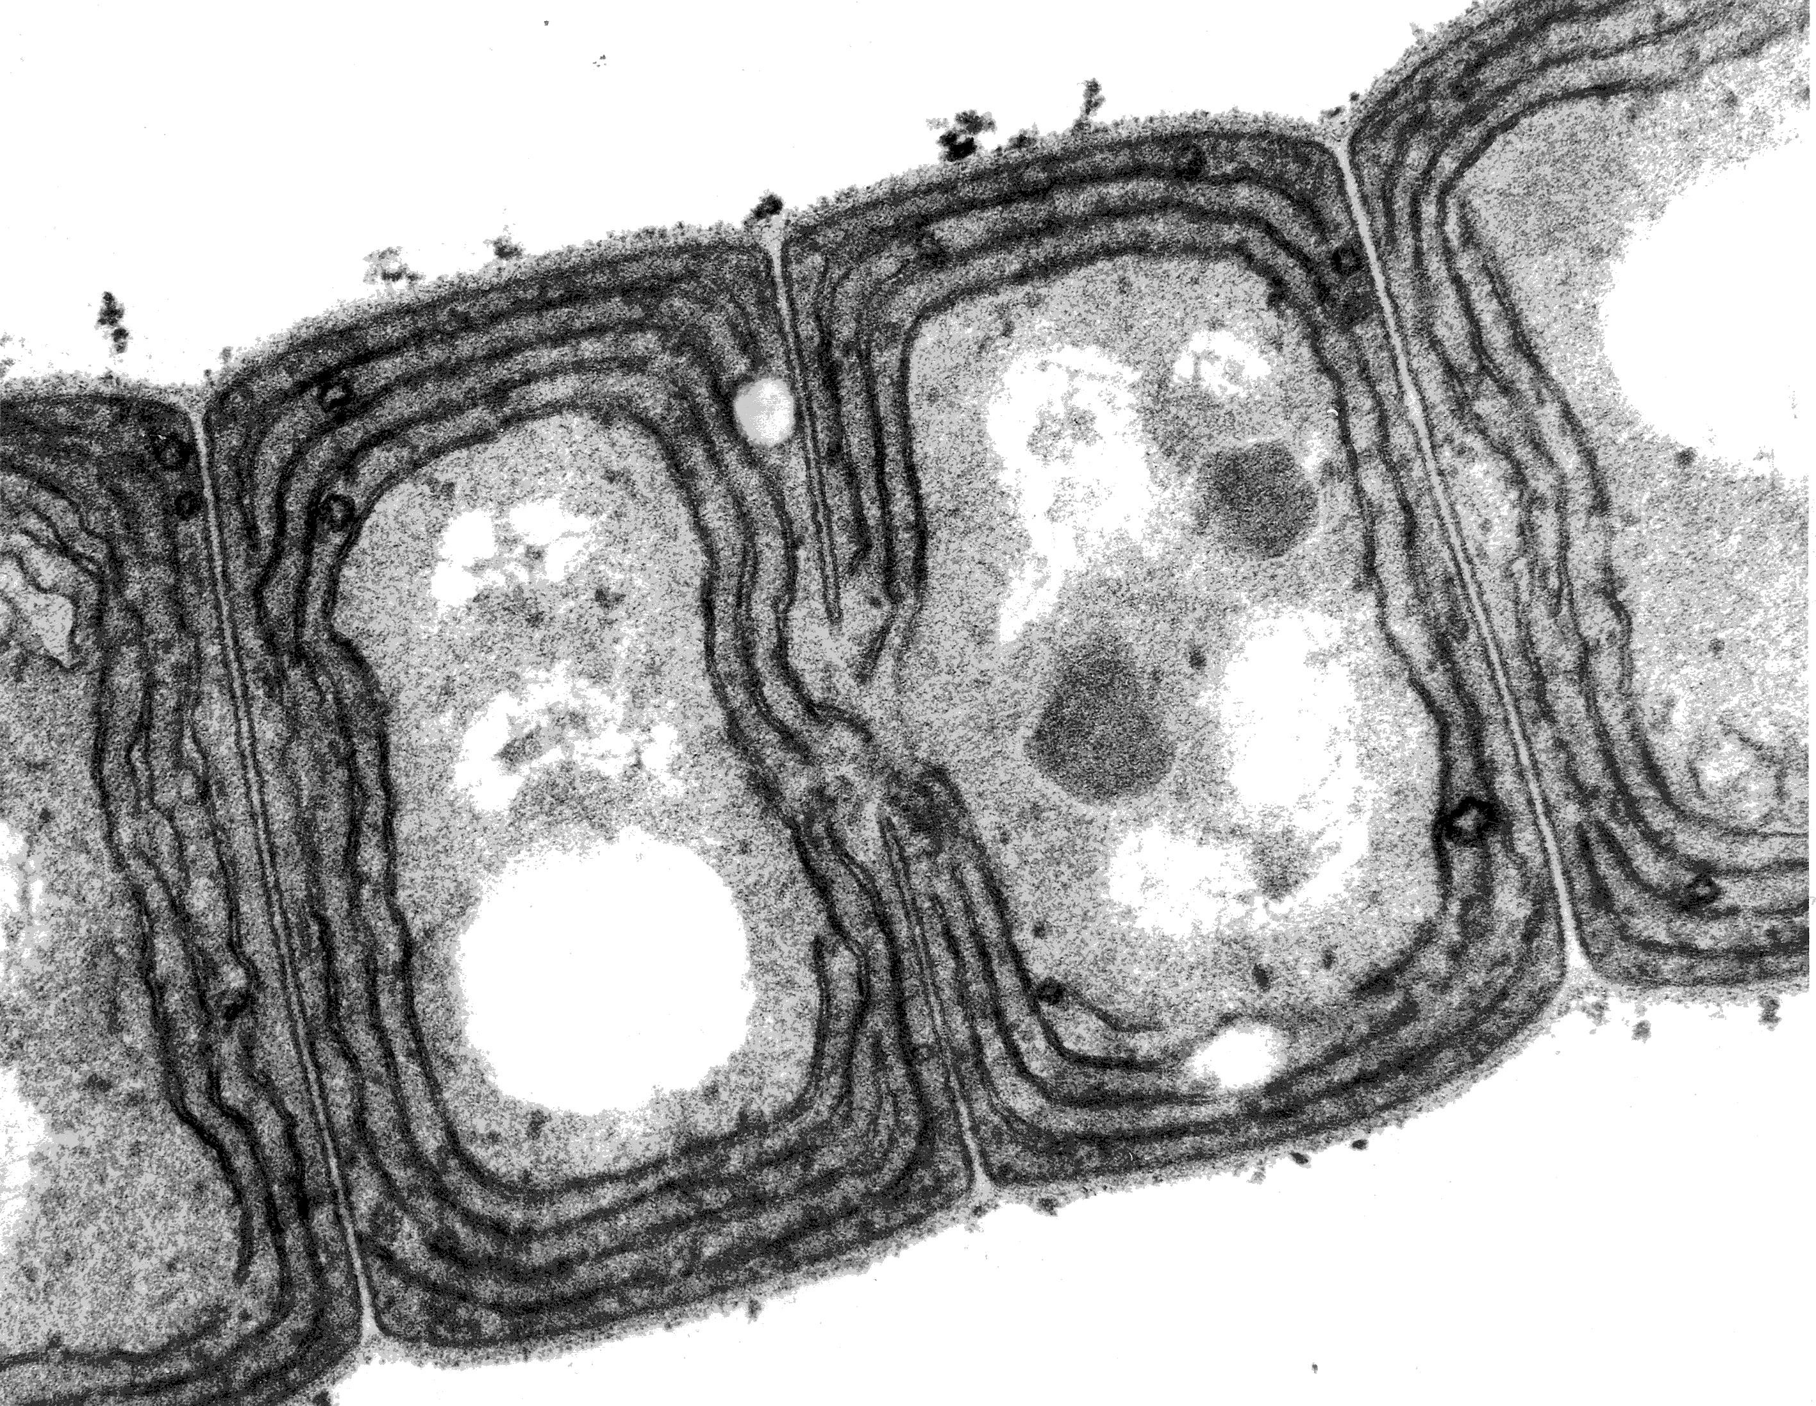

Slide 56
Ground Up Rebuild

Slide 57
Let’s Refactor

Slide 58
The Enterprise Model
One Ring to rule them all, One Ring to find them, One Ring to bring them all, and in the darkness bind them

Slide 59
Not all of a large system will be well designed.

Slide 60
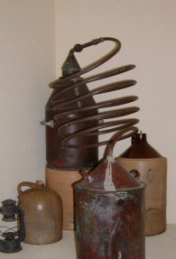
Distilling the Core Domain

Slide 61
Distilling the Core Domain
Generic Subdomains

Slide 62
Distilling the Core Domain
Generic Subdomains
Supporting Subdomains

Slide 63
Distilling the Core Domain
Generic Subdomains
Supporting Subdomains
Core Domain

Slide 64
Distilling the Core Domain
What makes your system worth writing?

Slide 65
Distilling the Core Domain
What makes your system worth writing?
Why not buy it off the shelf?

Slide 66
Distilling the Core Domain
What makes your system worth writing?
Why not buy it off the shelf?
Why not outsource it?

Slide 67
Distilling the Core Domain
What makes your system worth writing?
Why not buy it off the shelf?
Why not outsource it?

Slide 68
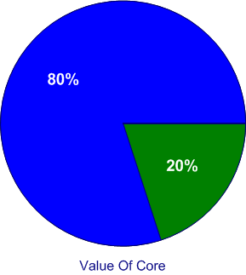
Effort Distribution

Slide 69
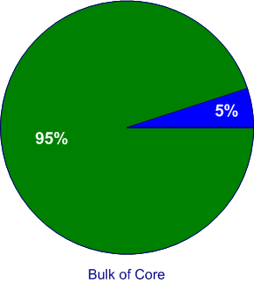
Effort Distribution

Slide 70
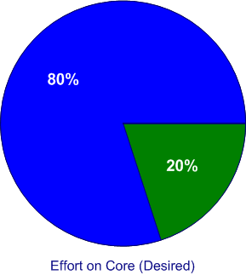
Effort Distribution

Slide 71
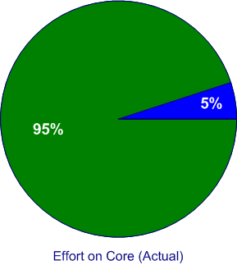
Effort Distribution

Slide 72
Ground Up Rebuild
Legacy Replaced
Year 1
Exciting New Features
Year 2
Year 3

Slide 73
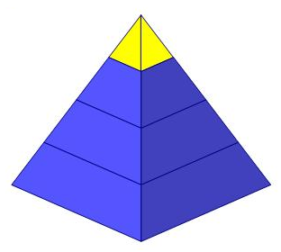
Which Part is Core?

Slide 74
Which Part is Core?

Slide 75
Responsibility Traps
…Or, Why do irresponsible programmers become heroes?

Slide 76
Let’s Hack

Slide 77
Let’s Hack

Slide 78
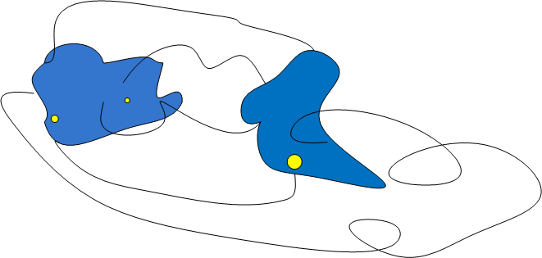
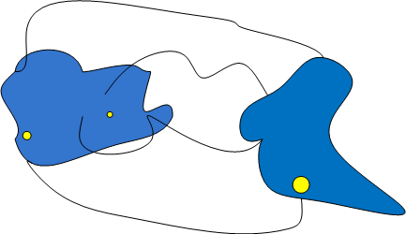
Which Parts are Core?

Slide 79
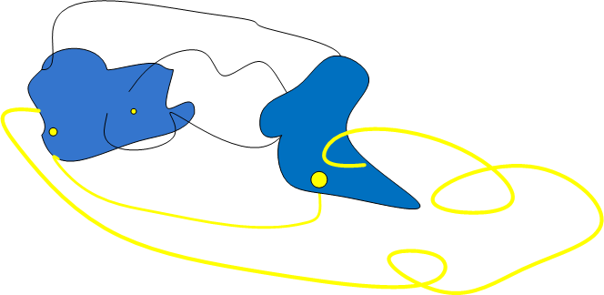
Which Parts are Core?

Slide 80
Responsibility Traps
Building a platform to make other (lesser) programmers more productive.
Cleaning up other people’s mess.

Slide 81
What’s a responsible designer to do?!!

Slide 82
How could we just build the core part?

Slide 83
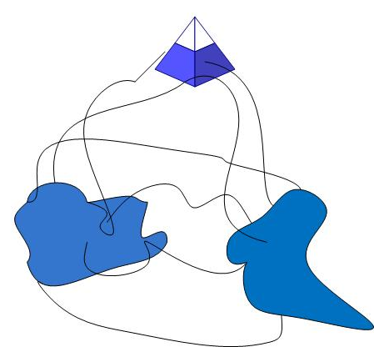
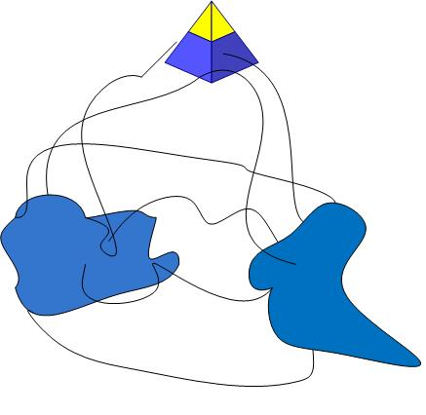
Build Platform Based on Model

Slide 84
Build Platform Based on Model

Slide 85
Strategy
Draw a Context Map.
Work with business leadership to define Core Domain.
Design a platform that supports work in the Core Domain.
Work with management to give freedom to the Core Domain Platform Context.
Develop and model in the Core Domain.

Slide 86
Strategy
Keep an eye on your Context Map.
Keep working with business leadership as Core Domain narrows and shifts.
Guard your platform that supports work in the Core Domain.
Keep working with management to maintain freedom of the Core Domain Platform Context.
Keep developing and evolving the model in the Core Domain.

Slide 87
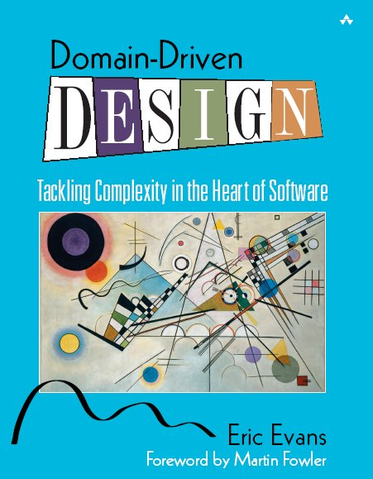
Strategic DDD Resources
www.domaindrivendesign.org
Domain-Driven Design
by Eric Evans
PART 4!
www.domainlanguage.com

Slide 88
6/6/24, 12:51 PM
Domain-Driven Design: Simple Explanation | Alex Hyett
NEWSLETTER ARTICLES BOOK NOTES
ALEX HYETT
FEED
Domain-Driven Design: Simple Explanation
In this article, we will cover:
Strategic Design
Tactical Design
Aggregate
Repositories and Services
When you are trying to build complex software it is important that everyone is on the same page. Even though most of us prefer to work alone, at home, with an endless supply of coffee, good software just isn’t built that way.
The software itself should represent the business and it should be clear from the code how the business functions. Software development is difficult enough without the business and engineering using different names for the same thing.
This is where Domain Driven Design (DDD) comes in, which was made popular by Eric Evans in his 2003 book Domain Driven Design: Tackling Complexity in the Heart of Software.
In this article, I am going to cover the key concepts that you need to know so that you can use DDD in your next project.
Watch this on YouTube!
Strategic Design
The first step in using DDD is what we call Strategic Design. Although it is possible to use DDD with an existing application it is a lot easier to do when the application
https://www.alexhyett.com/domain-driven-design/

Slide 89
6/6/24, 12:51 PM
is built with it in mind.
Domain-Driven Design: Simple Explanation | Alex Hyett
We need to work out what the different subdomains are in the business. A subdomain in this case refers to the subject area in which we are building the application and subdomains are part of that application.
It is important when working out the subdomains that you use the correct language.
You want the words that you use to describe objects in your application to be the same words that are used by the business. This has the grand name of “Ubiquitous language”, which is just a fancy way of saying, everyone needs to use the same words to describe the business.
Subdomains
Let’s use Netflix as an example. If we were to build Netflix from scratch using DDD then what domains would we have?
Video Streaming - this is obviously the main part of the business so this would be a core domain.
Recommendations- the recommendations engine and the machine learning involved is likely another subdomain.
Billing - billing and handling the monthly subscriptions could be another
subdomain.
There are likely quite a few more domains that we haven’t covered here as well.
Working out what the subdomains are should always be done as a group exercise with the business. If the engineering team tries to work out what the domains are themselves then it might not be representative of the business which defeats the whole point of using Domain Driven Design.
The aim here is to end up with a system that reflects the real-world domain that it is trying to solve.
Working out all the domains is going to be an iterative process. You might find that one of your domains is huge and needs to be broken down further.
Once you have worked out what the main domains are, the next step is to work out the key parts that make up each domain.
https://www.alexhyett.com/domain-driven-design/

Slide 90
6/6/24, 12:51 PM
Bounded Context
Domain-Driven Design: Simple Explanation | Alex Hyett
If we have a closer look at the billing domain we might have subscribers, accounts, payment details and subscription plans.
What you will notice when you go through this exercise is that there will be parts common across multiple subdomains. For example, the subscribers or users will likely come up across the whole system.
Each domain will have its own preference as to what to call the users. The billing domain may call them subscribers or customers. The video streaming domain might call them viewers.
DDD copes with this by creating what is called a Bounded Context. Each subdomain will have its own Bounded Context allowing the language to be used for each domain to be different.
You don’t need to try and force the whole business to agree on what to call “Users” you just need to agree on the language to use within that subdomain.
If you have done a good job you should find some clear separation between the different subdomains and the language used. Each subdomain should have at least a few things that are unique to just that domain.
For example, the billing domain will contain payment details which you wouldn’t expect to see in any of the other domains.
The aim here is to build up a model with the business of all the different elements that make up each domain. The elements inside the domain are called Entities which I will cover in more detail in a bit.
Relationships
Once we know what all the different subdomains are we need to work out how they interact and what relationships exist between them.
We do this by creating a Context Map which outlines which subdomains communicate with each other, how they communicate and the direction of the communication.
The interactions between subdomains will usually happen between entities.
https://www.alexhyett.com/domain-driven-design/

Slide 91
6/6/24, 12:51 PM Domain-Driven Design: Simple Explanation | Alex Hyett
Back to our Netflix example, the video streaming domain will need to know what video quality to stream to the viewers.
This all depends on what subscription plan they are paying for: Basic - HD
Standard - Full HD Premium - Ultra HD
The subscription plan however will be outside the bounded context of the streaming domain. It doesn’t need to know what users are paying it only cares about streaming videos.
The steaming domain will therefore need to check with the billing domain to find out what quality video to serve to the user.
Of course, the billing domain doesn’t care about video quality it only cares about the user’s subscription plan.
So we need to do a mapping between the viewer in the streaming domain with the subscriber in the billing domain.
Now to make sure we don’t pollute either domain with information that doesn’t need to be there, we create what we call an anti-corruption layer which does the translation between domains for us.
Once we have outlined all the domains and how they all interact we move on to the next stage which is tactical design.
Tactical Design
In this stage, we look at trying to refine our domain models a bit further. To do this we look at each of our domains and work out what all the objects are inside them.
Domain Objects come in two forms.
Entities
The entities of a domain object link to their real-world counterparts. So an example of an entity might be the subscriber in our Netflix example.
https://www.alexhyett.com/domain-driven-design/

Slide 92
6/6/24, 12:51 PM Domain-Driven Design: Simple Explanation | Alex Hyett
Each entity has an ID and it is this ID that makes them unique. Two different entities with the same properties would be considered different entities if they have different IDs.
Entities are mutable, you can change their properties over time. For example, a subscriber could change their email address and it would still be the same subscriber as it has the same ID.
The other domain objects to consider are called Value Objects.
Value Objects
A value object, as the name suggests, generally corresponds to a value in your domain.
Entities can consist of several value objects. For a subscriber, this could be their email address or their date of birth.
Value objects are not unique and two objects with the same value are considered equal. If you are creating value objects in languages like C# or Java then you will need to override the Equals and HashCode methods so that when you compare them they are considered equal.
Unlike Entities, Value Objects should be immutable. You can’t update them, if you need a different value then you just create a new one.
We generally do this by only allowing values to be entered in the constructor and then not providing any setter methods.
The key thing to understand here is they are an object. You could just as easily create a string to store the email address but by creating a Value Object you are explicitly saying that this is an important part of your domain.
The fact that it is an object means that you can add additional validation and business logic in the constructor. This can be really useful. For example, if you have an email address object, you don’t need to check everywhere in your code that it is in fact a valid email address, you can do that inside the value object.
Even if you don’t end up using Domain Driven Design, value objects can be a great way to write cleaner code in your applications.
https://www.alexhyett.com/domain-driven-design/

Slide 93
6/6/24, 12:51 PM
Entity or Value Object?
Domain-Driven Design: Simple Explanation | Alex Hyett
When modelling your objects it can be difficult to decide whether something should be an entity or a value object.
Generally, it depends on how important that object is in your domain model. For example, in many domains, the address is just information. It is part of the billing details but doesn’t have any meaning in the system beyond that.
Now imagine you are creating a real estate application. Now the address isn’t just information, it is key to understanding the property. In this case, it is more likely to be an entity.
Generally, you want to have more Value Objects than Entities in your domain as value objects are simpler to work with as they are small and immutable.
Aggregate
Now that we know about Entities and Value Objects, the next important object to consider in DDD is called an aggregate.
An aggregate, as the name suggests, is a group of several entities and value objects.
An example of an aggregate could be a customer’s order. It is made up of the customer, the products they have ordered, the order price and other details such as the shipping address.
An aggregate is also a transactional boundary, so whenever changes are made they should be either committed or rolled back in a single transaction to the database. This way the aggregate is always in a consistent state.
Like Entities, aggregates also have an ID so they can be referenced from other parts of your application.
The aggregate is also responsible for enforcing business invariants. These are business rules that always remain true no matter what you do in the system. For example, you might have a rule that the order total should be the sum of the products ordered. You might have another rule that stops people from ordering more of a product than what is in stock.
https://www.alexhyett.com/domain-driven-design/

Slide 94
6/6/24, 12:51 PM Domain-Driven Design: Simple Explanation | Alex Hyett
Obviously, all of this comes at a cost. The more rules that you add to your aggregate, the longer it is going to take to do updates, which could affect user experience.
So generally there is a bit of a trade-off between performance and consistency that you need to keep in mind. In some cases, it makes more sense to add what we call a corrective policy that will run on a regular basis, which will either fix or flag anything that isn’t correct.
Repositories and Services
Finally, we have repositories and services, which if you have done any backend development you will probably be familiar with.
The repositories in this case are the persistence layer for our aggregates so that they can be stored in the database.
Then we have services which contain additional business logic which either won’t fit into a single aggregate or spans multiple aggregates.
Once you have everything mapped you are ready to start building the application.
If you want to learn the best approach to do that I suggest your read this article on hexagonal architecture.
Metadata
Published
2023-04-28
Tags
#programming
Now Subscribe About Blogroll Affiliate Disclaimer
© 2015 - 2024 Alex Hyett
https://www.alexhyett.com/domain-driven-design/

